Slide 1
EYFS Maths Workshop
29/11/2021

Slide 2
Parent voice
How were you taught Maths at school?​
What are your early memories of Maths lessons?​
What was, and is, your attitude to Maths?
Are you confident with your mathematical skills?
Have you always enjoyed it?

Slide 3
EYFS Statutory Framework
Developing a strong grounding in number is essential so that all children develop the necessary building blocks to excel mathematically. Children should be able to count confidently, develop a deep understanding of the numbers to 10, the relationships between them and the patterns within those numbers. By providing frequent and varied opportunities to build and apply this understanding, children will develop a secure base of knowledge and vocabulary from which mastery of mathematics is built.
In addition, it is important that the curriculum includes rich opportunities for children to develop their spatial reasoning skills across all areas of mathematics including shape, space and measures.
It is important that children develop positive attitudes and interests in mathematics, look for patterns and relationships, spot connections, ‘have a go’, talk to adults and peers about what they notice and not be afraid to make mistakes.

Slide 4
Important Mathematical Aspects
Early Number Sense
A well organised conceptual framework of number information that enables a person to understand numbers and number relationships and to solve mathematical problems.
Spatial Reasoning
The neural circuitry used to build up a child’s understanding of their external environment and the way they orientate themselves spatially is also used to process numbers and more abstract thinking.
Rich adult-child interactions
High-quality adult–child interactions in the form of sustained shared thinking is important in extending children’s learning.
Notes:
Spatial Resaonsing:
understanding relationships – how things fit together, how moving parts work
language – hearing, describing, directing; position, direction
spatial memory – where things are
sense of direction – finding your way back
spatial representations – creating mental images, composing and deconstructing; perspective and movement; understanding models, maps, diagrams.
Sustained Shared Thinking
occurs when two or more individuals “work together” in an intellectual way to solve a problem, clarify a concept, evaluate an activity, extend a narrative etc. Both parties must contribute to the thinking and it must develop and extend the understanding.”

Slide 5
Mathematical Development
Just as babies are born with some innate understanding of language, they also have the ability to appreciate quantity.
The first obvious stage of learning about number is, for most children, learning number names. At this stage, though, they don’t connect the names with a quantity, or understand that they come in a fixed order.
The next stage is for children to learn the number names and then master the sequence and get them in the right order, which involves a huge amount of working memory. To make matters harder, they need to count as far as the twenties before they hear a repeating pattern.
Notes:
- Recognising an amount is the first step. From there we regularly use the language of more and then less/fewer.
– In everyday life, many number symbols we see and use are distinguishing labels – for example, bus numbers, shoe sizes, road numbers, etc. Typically, it is quite rare to see numbers attached to quantities. for instance, the number on a 64 bus does not mean that 63 buses have already passed by; a shoe numbered ‘5’ does not mean that I have four other pairs of shoes.

Slide 6
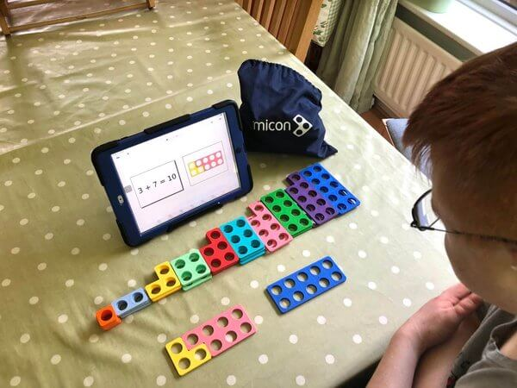
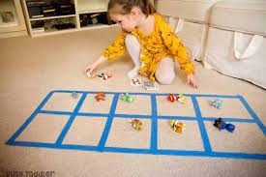
What does Maths look like in Early Years?
Direct teaching time (White Rose Maths and NRich activities)
Planned mathematical environment and observations of children’s self-directed play
High quality adult-child interactions
Making Maths ‘real’ for children –familiar contexts with
meaningful purposes​
Implementing the Maths Mastery Scheme: Depth vs. Breadth
Notes:
Teaching:
Key counting concepts and principles
Environment:
Putting ‘Maths’ opportunities in all of the 7 learning areas (cross-curricular links) – inside and outside the classroom!​
Problem Solving Activities & Open-Ended Child Led Investigations.​
Interactions:
Giving children the opportunity to reason and explain and to record their findings systematically.
Mastery:
Why numbers 1-10? Most children come in being able to count to 10, 20 or even 100 but do they associate numbers and quantities? Do they actually know what those numbers actually mean? Children handle, sort and compare different objects to explore what the numbers mean and their true value.
Able to feel the change in quantities, explore and experiment.
Learning the composition of early numbers in depth helps later learning as they begin to recognise pattern in number and can apply prior knowledge to large numbers and more in depth concepts. The harder principles are easier to grasp.

Slide 7
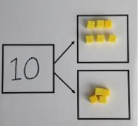
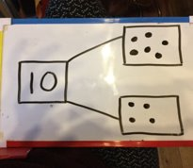
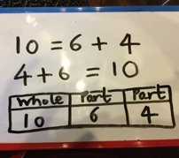
The CPA Model
C = Concrete P = Pictorial A = Abstract​
​
“One part is 4 and one part is 6. I know that 6 and 4 makes 10.”​
Notes:
Importance of using large/small manipulatives to explore amounts, practise and problem solve.

Slide 8
Counting: Key Principles
One to One Principle
Stable Order Principle
Order Irrelevance Principle
Cardinal Principle
Conservation of Number Principle
Abstraction Principle

Slide 9
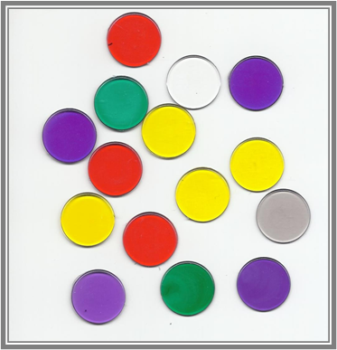
One to One Principle
Need to count each object once and only once.
Sometimes skim and miss out an object or count an object more than once. Often when objects are not in a line.
We say “Line them up, tap each one, count out loud, carefully and slowly”

Slide 10
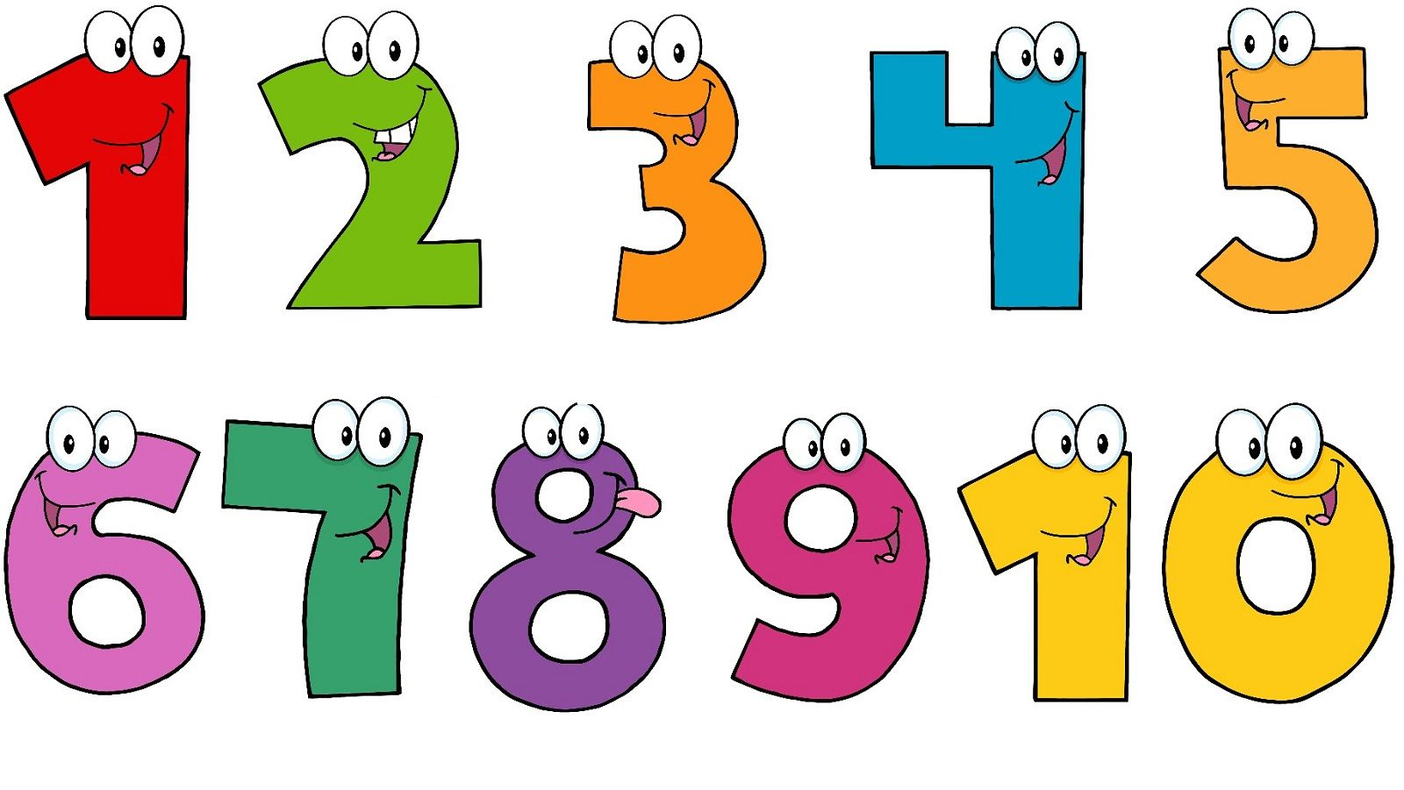
Stable Order Principle
Number names being said in the correct order and this never changes.
First 2 principles often come hand in hand.
We sing lots of counting songs and rhymes.

Slide 11
Order Irrelevance Principle
Knowing the order in which a group is counted is not important.
The total number remains the same.

Slide 12
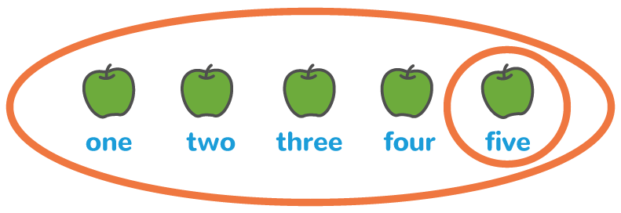
Cardinal Principle
The final number said is the total number.

Slide 13
Conservation of Number Principle
Knowing that the number of objects does not change even if the objects are moved around.
E.g. Spread out or close together.

Slide 14
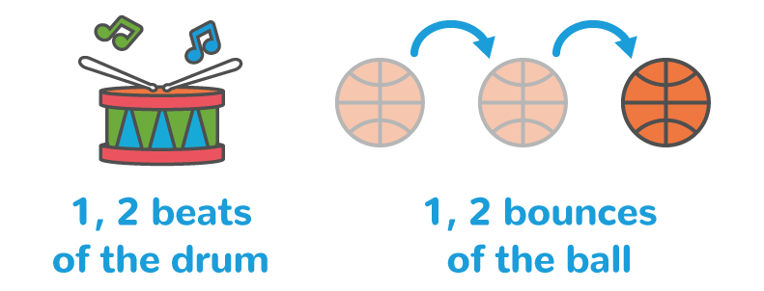
Abstraction Principle
Anything can be counted. Whether they can be touched or not.
E.g. counter, buses, claps, jumps.

Slide 15
Representing Numbers​
Numbers can be represented in many ways, not just as a written numeral
We use many different objects and pictures to show that numbers can be represented in lots of ways. ​
​
Children sometimes need lots of practise to recognise numbers in different forms. We play games that encourage children to recognise and make different amounts both indoor and outdoor

Slide 16
Subitising
Another skill is to develop other mental strategies to identify the number of items in a group without counting them individually.
e.g.
5
Do these still represent the number 5?
••• ••
•• •• •

Slide 17
Reasoning
It helps them to:
think about how to solve a problem
explain how they solved it
to think about what they could do differently.
Some examples of reasoning are:
Spotting incorrect Maths eg 1, 3, 2, 4, 5
Explaining how we know something or how we worked it out
Notes:
Sustained shared thinking

Slide 18
Problem solving
Allows children to use and apply their Maths skills in lots of contexts and in situations that are new to them
In Reception, problem solving might include:
spotting, following and creating patterns
estimating amounts of objects
predicting how many times they can do something in a minute
sharing objects between different groups – particularly when the amount of groups change and the amount of objects stays the same
finding different ways to partition numbers eg 5 could be 5+0, 4+1, etc
Notes:
Sharing the biscuit!

Slide 19
Maths Early Learning Goals: Number
Have a deep understanding of number to 10, including the composition of each number; 14
Subitise (recognise quantities without counting) up to 5;
Automatically recall (without reference to rhymes, counting or other aids) number bonds up to 5 (including subtraction facts) and some number bonds to 10, including double facts.

Slide 20
Maths Early Learning Goals: Numerical Pattern
Verbally count beyond 20, recognising the pattern of the counting system.
Compare quantities up to 10 in different contexts, recognising when one quantity is greater than, less than or the same as the other quantity.
Explore and represent patterns within numbers up to 10, including evens and odds, double facts and how quantities can be distributed equally.

Slide 21
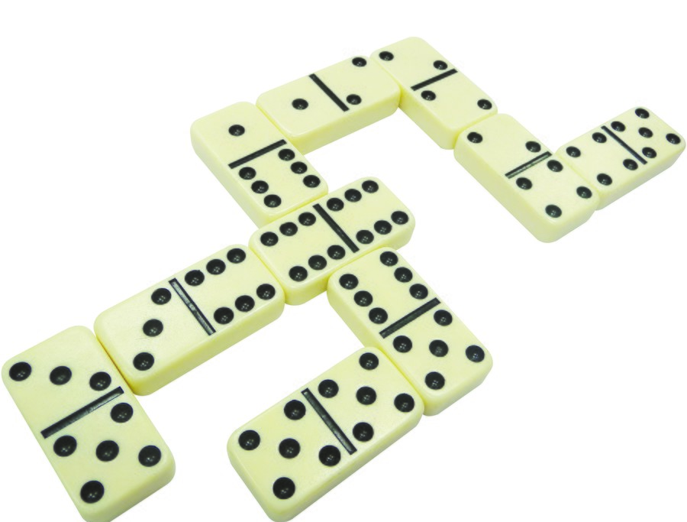
Maths at Home: Number
Sing songs!
Count- steps up the stairs, money into a money box, etc
Ask children to say how many without counting (5 or fewer)
Play games using dice/dominoes and encourage child to say how many spots without counting
Ask children to set the table with enough knives, forks and plates for everyone
Spot numbers in the environment – on phones, microwaves, clocks, registration plates, doors

Slide 22
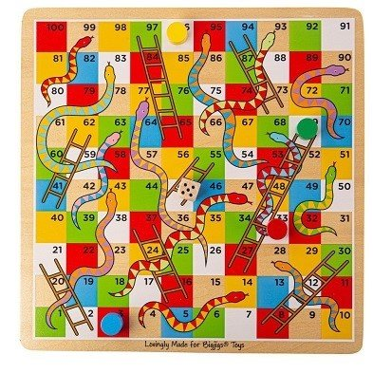
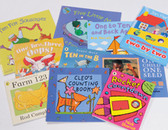
Maths at Home: Number
Draw attention to more and less
Deliberately make mistakes. e.g. get mixed up when counting, muddle two numbers when ordering them
Hide numbers around the house or garden for children to find
Play outdoor maths games like hopscotch and skittles
Simple board games
Read books with Mathematical concepts e.g. ’The Very Hungry Caterpillar’, ‘One is a Snail, Ten is a Crab’, ’What’s the Time, Mr Wolf?’
Notes:
Children need to understand mistakes are normal and everyone makes them, as well as improving mathematical understanding
Even better, let children make up their own games and decide how to score points.
Learning turn taking, direction, communication and language

Slide 23
Maths at Home: Spatial Awareness
Construction games – making and discussing
Creating and fixing patterns
Having a treasure hunt using positional language
High-quality jigsaws with increasing number of pieces
Making pictures from shapes
Throwing and catching
Fuzzy felt
Read books with Mathematical concepts e.g. ‘Square’, ‘Circle’, ‘Triangle’ (by Mac Barnett), ‘Walter’s Web’

Slide 24
Useful Sites
https://www.youtube.com/watch?v=2Ow8vEmh8lA
Explanation of early number sense
https://www.topmarks.co.uk/maths-games/3-5-years/
Counting / Patterns / Addition and Subtraction / Number Ordering
https://www.westkirbyprimaryschool.co.uk/website/foundation_stage/53930
WKPS EYFS Home Learning Activities: F1/F2

Slide 25
Thank You! Any questions?

